Slide 1

Stage 1 V for Anarchy Course Designer: Marcel Englmaier
V for Anarchy is a 28 round, 140 point Comstock Long course course. There are 14 IPSC targets. The best two hits per target will score. The start signal is audible.
The Handgun start position is standing anywhere with wrists below belt. Handgun is loaded and holstered. The PCC start position is standing anywhere with PCC loaded, safety on, stock on belt.
On the audible start signal, engage all targets from within the shooting area.

Slide 2
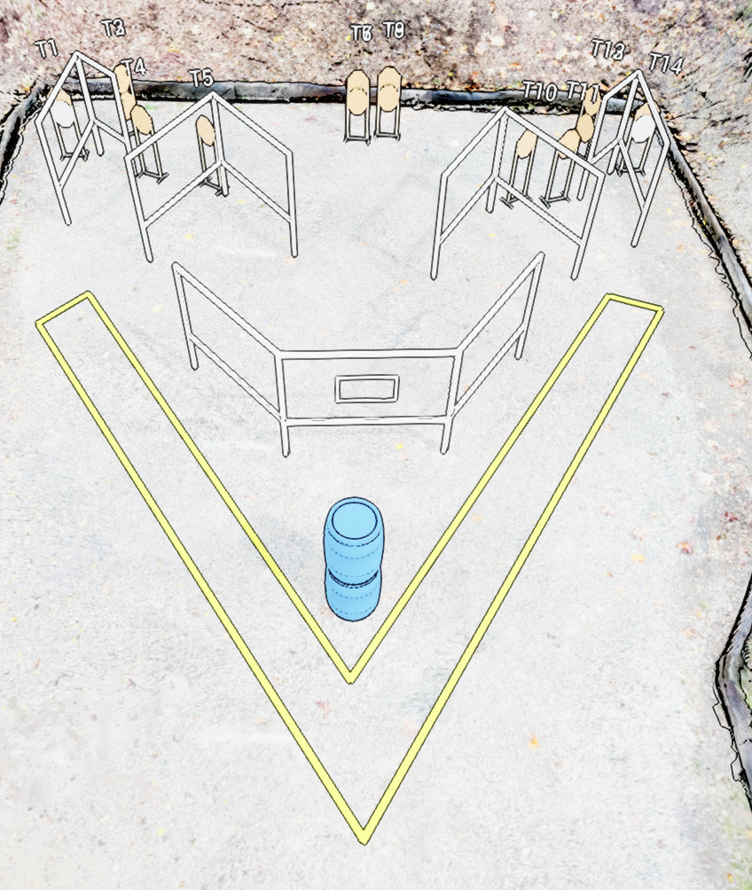
 | Stage 1 V for Anarchy Course Designer: Marcel Englmaier

